Slide 1
Building Applications Using Spring JDBC 5
COURSE OVERVIEW

Slide 4
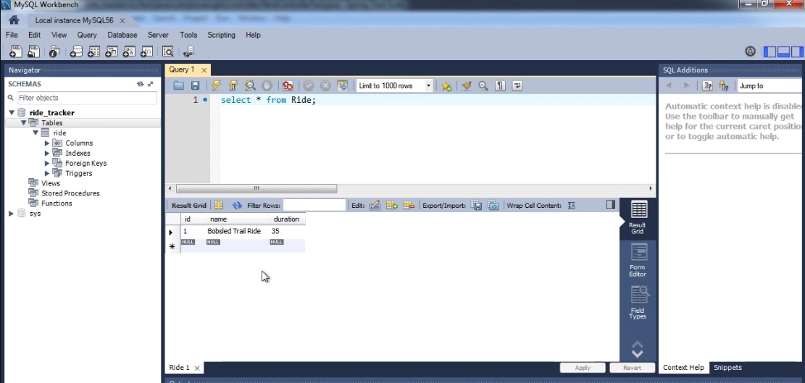

Slide 6


